Slide 1
UNIT 2: Nutrients from Food groups and methods of cooking

Slide 2
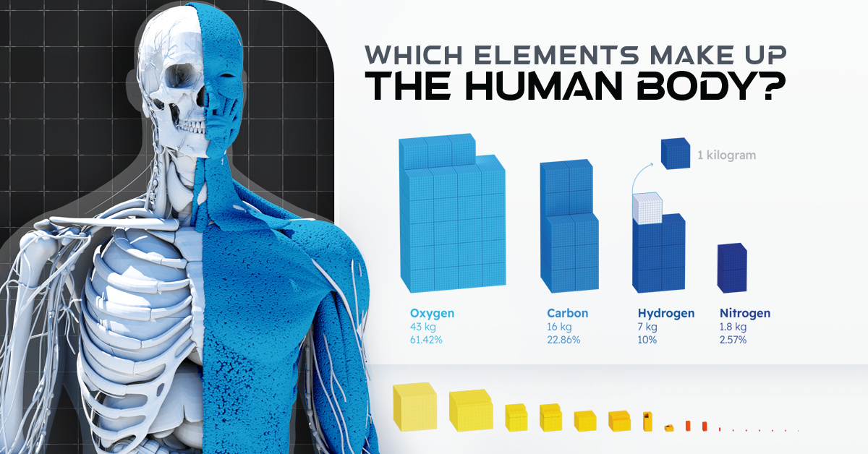

Slide 3
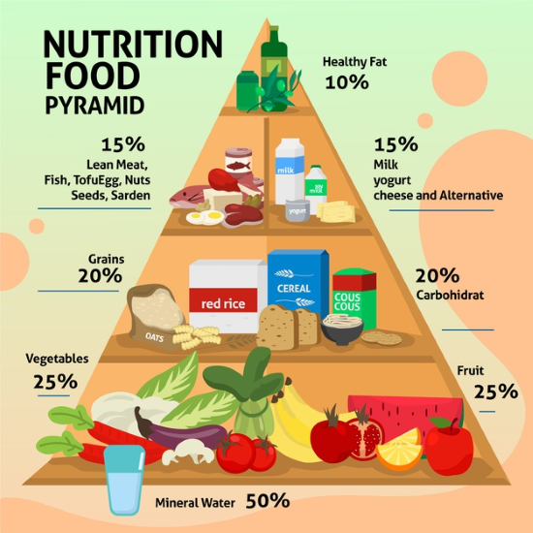
Types of Nutrients
An essential nutrient is a nutrient that the body cannot synthesize on its own or not to an adequate amount and must be provided by the diet/ food consumed.
These nutrients are necessary for the body to function properly. The six essential nutrients include carbohydrates, protein, fat, vitamins, minerals and water.

Slide 4
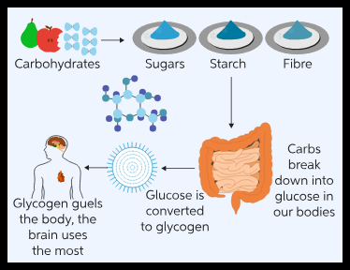
Carbohydrates
Carbohydrates, or carbs, are sugar molecules. It is one of the main or macro nutrient of food. body breaks down carbohydrates into glucose.
Glucose, or blood sugar, is the main source of energy for your body's cells, tissues, and organs. Each gram of carbohydrates provides 4 calories.
Without carbohydrates, brain and in turn the body could not function properly.
Brain has a very high rate of metabolism, using ~5.6 milligram glucose per 100 gram of brain tissue per minute. Hence, Carbohydrates are the only nutrients which can match this rate of energy requirement.
Notes:
Normal wt of human brain is 1300-1500gm. Hence requirement of glucose for 24h is??

Slide 5
They are hydrates of carbon containing C, H and O
Sources include fruits, breads and grains, starchy vegetables and sugars. It is advisable to make at least half of the grains you consume in form of whole grains.
Whole grains and fruit are full of fibres, which reduces the risk of coronary heart disease and helps maintain normal blood glucose levels.

Slide 6
Carbohydrates have four major functions within the body:
Providing continuous energy and regulation of blood glucose
Sparing the use of proteins for energy: In a situation where there is not enough glucose to meet the body’s needs, glucose is synthesized from amino acids. Because there is no storage molecule of amino acids, this process requires the destruction of proteins, primarily from muscle tissue.
Energy storage – in the form of glycogen
Building Macromolecules- Although most absorbed glucose is used to make energy, some glucose is converted to ribose and deoxyribose, which are essential building blocks of important macromolecules, such as RNA, DNA, and ATP (Adenosine triphosphate called as the energy currency of the cell).

Slide 7
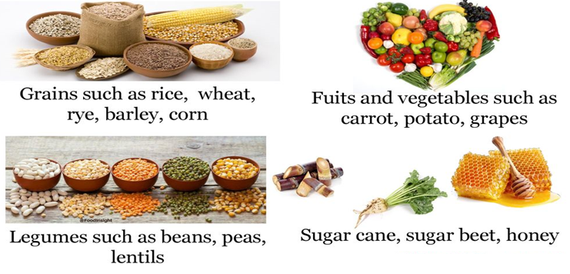
Common sources of naturally occurring carbohydrates include:
Types of Carbohydrates:
1. Sugar is the simplest form of carbohydrate. It occurs naturally in some foods, including fruits, vegetables, milk and milk products. Types of sugar include fruit sugar (fructose), table sugar (sucrose) and milk sugar (lactose). Added sugars can be found in many foods, such as cookies, sugary drinks and candy.
Sugars can be further categorized as:
Monosaccharides- They are simple sugars that contain from 3 to 7 carbon atoms Eg. Glucon-D
Disaccharides: They are simple sugars formed from the combination of two monosaccharides by dehydration synthesis eg. table sugar

Slide 8
2. Polysaccharides from tens to hundreds of monosaccharides joined by dehydration synthesis.
Eg. Starch: Starch is a complex carbohydrate. This means it is made of many sugar units bonded together. Starch occurs naturally in vegetables, grains, and cooked dry beans and peas.
3. Dietary Fiber: Fiber also is a complex carbohydrate. It also known as roughage or bulk, includes the parts of plant foods your body can't digest or absorb. It occurs naturally in fruits, vegetables, whole grains, and cooked dry beans and peas.
Fibers normalizes and maintains bowel movements, lower sugar and cholesterol, maintains healthy weight.

Slide 9
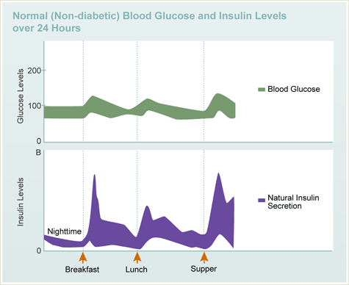
Carbohydrate sugar Insulin a Case Study
Normal sugar level of 70 to 130 mg/dL before meals and less than 180 mg/dL after 2 hours of meals.
Insulin is continuously released from the pancreas into the blood stream. Although the insulin is quickly destroyed
(5-6 minutes).
Spike in insulin observed when we eat food due to increase in glucose in blood.
At mealtime, a little insulin is released even as you are first smelling or chewing the food. This gets your body ready to receive the sugar load from the meal. Then as you eat and the food is digested, the sugar levels rise which causes a surge of insulin. The insulin levels rapidly climb and peak in about 45 minutes to 1 hour
Notes:
Insulin is an essential hormone produced in pancreas. It helps your body turn food into energy and controls your blood sugar levels.
The situation is different when you have diabetes and are getting insulin replacement therapy. Once you have injected a dose of insulin, it is going to get absorbed into your bloodstream whether you need it or not.

Slide 10
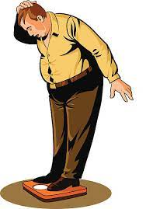
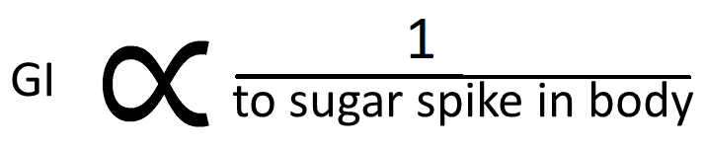
Too many simple carbs can contribute to weight gain. They can also increase your risk of diabetes, heart disease and high cholesterol. Hence compare your carb intake.
How can you do this?
A tool called the glycemic index (GI) can help. It rates carbohydrate-containing foods by how much they boost blood sugar (blood glucose).
The glycemic index (GI) is a rating system for foods containing carbohydrates. It shows how quickly each food affects your blood sugar (glucose) level when that food is eaten on its own.

Slide 11
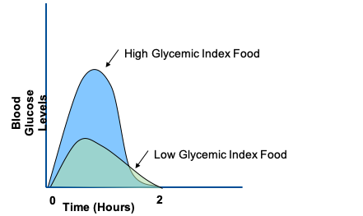
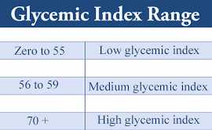
The glycemic index classifies carbohydrate-containing foods according to their potential to raise blood sugar levels. Weight-loss diets based on the glycemic index typically suggest limiting foods that are higher on the glycemic index. Foods with a relatively high glycemic index ranking include potatoes, white bread, and snack foods and desserts that have refined flours.
Many healthy foods are naturally lower on the glycemic index. Examples include whole grains, legumes, vegetables, fruits and low-fat dairy products.
Different carbohydrates are digested and absorbed
at different rates

Slide 12
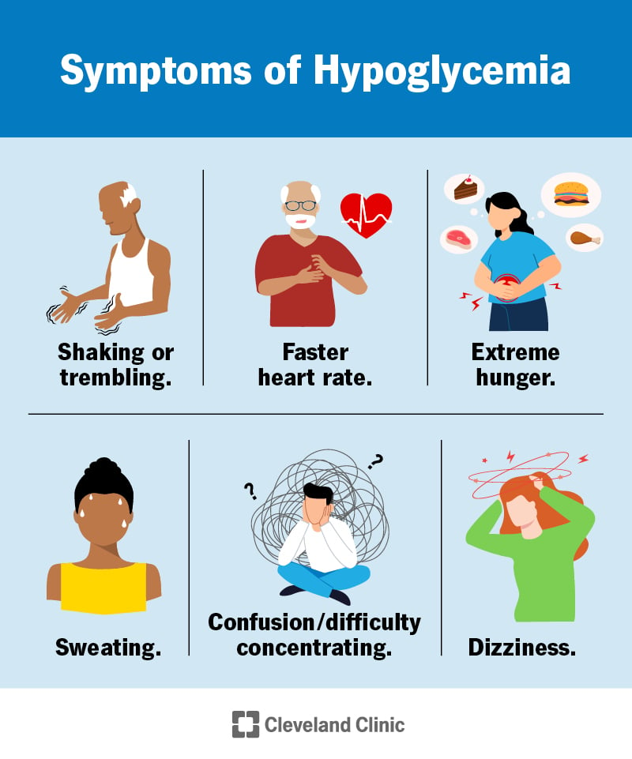
What happens if I don’t get enough carbohydrates?
When you don’t get enough carbohydrates, the level of sugar in your blood may drop to below the normal range (70-99 mg/dL), causing hypoglycemia. Your body then starts to burn fat for energy, leading to ketosis. It occurs when glycogen in the human body is depleted.
In case one’s body is carbohydrate deficient, it will utilize fats and protein for energy. Most people avoid carbohydrates in order to avoid gaining weight. Skipping carbohydrates makes you prone to several carbohydrate deficiency diseases. Ketosis is an elevation of ketone levels in the body. Ketone production is increased in several situations, including when you follow a very low carb diet.
Normally, your body prefers to use blood sugar, also called glucose, for energy. However, during ketosis, your body gets more of its energy from ketones, which are produced from fat.

Slide 13
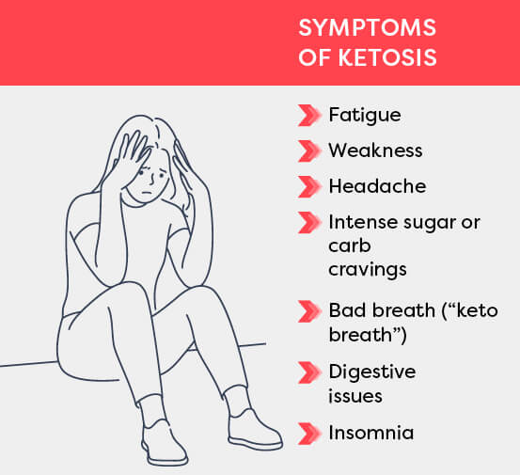
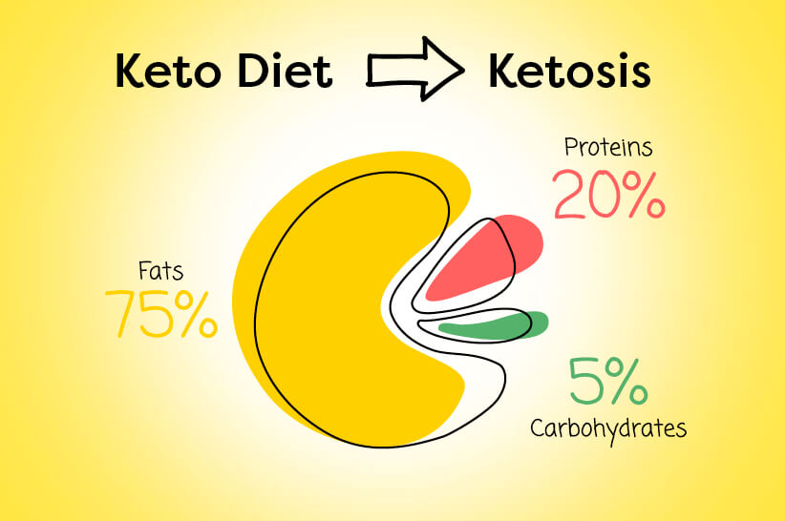

Slide 14
Carbohydrates have a bad reputation​
​
They tend to take the blame when people gain weight – but are they the true culprit?​
It’s true, there are some bad carbs, but not all carbs are bad. ​
But…..
Many carbs are important because they get turned into fuel for your body.

Slide 15
Carbohydrates that are naturally found in plant-based foods, are typically good carbs. This type of carb is also called a complex carb which promotes a healthy digestive system and metabolism.​
​
​
Bad carbs are added to processed foods as starches and sugars, which have a variety of consequences. These are called simple carbs, which are absorbed into the bloodstream and become blood sugar. ​

Slide 16
Simple carbs are the bad kind. ​
​
These are carbohydrates that have many of their necessary nutrients removed. Simple carbs are digested quickly, causing spikes in blood sugar and making you feel hungry sooner. ​
​
The short-lived fullness leads to overeating, weight gain, and conditions like diabetes and high blood pressure. ​
Popular foods with simple carbs include:​
White bread​
Enriched or refined pasta​
Enriched or refined dough​
Pastries​
White rice ​
Table sugar, honey​

Slide 17
Complex carbs are the good kind. ​
​
They are often packed with nutritional layers like bran and fiber that make you digest them ​
slower. ​
​
Not digesting as fast also leads to a slow but steady release of glucose, preventing spikes​
in blood sugar.
Opting for complex carbs provides two major benefits. ​
​
First, you get the same food but as a complex carb and with all the benefits that accompany it.​
​
Second, you are less likely to eat something processed that has a lot of added sugars.​

Slide 18
Benefits of Healthy Carbs​
Because carbs are fuel for our body, a lack of healthy carbs can have negative effects.​
Carbs fuel several organs and systems, such as our:​
Brain​
Kidneys​
Heart muscles​
Central nervous system​
Digestive system ​
​
A diet without enough carbs can lead to:​
Headaches​
Fatigue​
Weakness​
Lack of focus and difficulty concentrating​
Nausea​
Constipation​
Vitamin and mineral deficiencies ​

Slide 19
Choosing Healthy Carbs​
You don’t have to be a nutritionist or counting carbs to benefit from a diet of healthy carbs​
​
The Plate Method is a powerful way to focus on healthy carbs. ​
Half of your plate should be fiber-rich and starch-free vegetables. ​
A quarter of the plate should be starchy foods, whether that’s vegetables like potatoes or a fruity dessert. ​
The last quarter of the plate should be lean protein. ​
​
It can be difficult quitting bad carbs!!!!​
​
Rather than cutting away pieces of your diet, find replacements for them. ​
Instead of colas, try sparkling water. In place of white bread, opt for whole-grain bread. ​
With a little bit of work, you can replace bad carbs with good carbs. ​

Slide 20
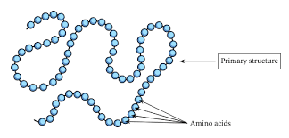
Protein (Chain of amino acids)
Proteins are large biomolecules and macromolecules that comprise one or more long chains of amino acid residues that are peptide-bonded.
Protein is found throughout the body—in muscle, bone, skin, hair, and virtually every other body part or tissue.
10 to 35 percent of our daily calories should come from lean protein sources such as low-fat meat, dairy, beans or eggs.
The average person needs about 7 grams of protein every day for every 20 pounds of body weight.

Slide 21
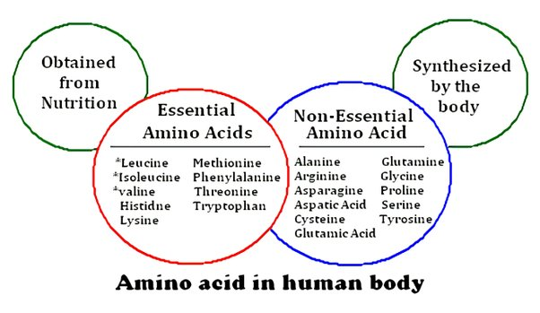
Role of protein
Protein is the major structural component of cells and is responsible for the building and repair of body tissues. Protein is broken down into amino acids, which are building blocks of protein. You need protein in your diet to help your body repair cells and make new ones. Nine of the 20 amino acids, known as essential amino acids, must be provided in the diet as they cannot be synthesized in the body.
human body lacks the metabolic pathways required to synthesize these amino acids.

Slide 22
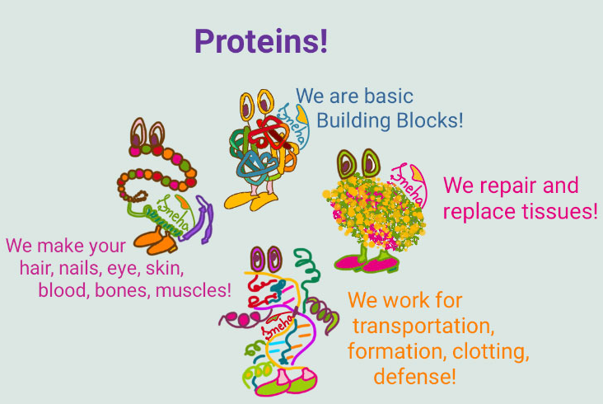
Classification on the basis of biological Functions of proteins:
Proteins perform a numerous functions in the organisms. The main functions of proteins are as follows:
Structural Proteins: Many proteins serve as building material of cells and tissues. Some proteins form supporting structures, e.g., elastin of ligaments, collagen of tendons, cartilages, bone and connective tissue. Keratin is the major constituent of external protective structure of animals like hair, feathers, layer of skin, nails, claws, hoofs etc.

Slide 23
2. Enzymes: Many proteins function as enzymes to catalyze biochemical reactions that occur in the living world. Enzymes play a key role in the metabolism.
Every enzyme is specific in action. E.g., Amylase, protease, RUBISCO etc.
Amylase is necessary for breaking down the bonds in starches, polysaccharides, and complex carbohydrates into simpler simple sugars.

Slide 24
3. Carrier Proteins (Transport proteins): A carrier protein is a membrane protein which bind and transport specific molecules across a membrane or in a body fluid.
Eg. Haemoglobin of RBCs transports oxygen in the body. RBCs contain haemoglobin (Hb) which is made up of 4 polypeptide chains and contains an iron ion. Iron has strong affinity for oxygen. In lungs, oxygen combines with haemoglobin to produce oxyhaemoglobin. In body cell, oxygen is released and is able to diffuse into body cell.
Other examples include proteins such as myoglobin of muscles store oxygen. α-globulin of blood carries thyroxine and bilirubin, β-globulin transport vitamins A, D and K, cholesterol and ions in the blood.

Slide 25
4. Receptor Proteins: A number of proteins present on the external surface of cell membrane act as receptor molecules.
A receptor protein molecule receives chemical signals from outside a cell. When such chemical signals bind to a receptor, they cause some form of cellular/tissue response.
For example, insulin receptor protein:
when insulin is released in blood, the receptor proteins present on cell membrane binds with this insulin. This binding changes the permeability of cell membrane and glucose can enter the cell through glucose channels.

Slide 26
5. Hormones: Some hormones are proteinaceous, e.g., insulin (sugar metabolism regulating hormone} parathyroid (calcium and phosphate transport regulating hormones). Hormones play a key role in the regulation of metabolism.
6. Contractile Proteins: Actin and myosin are two protein molecules in muscles and are mainly involved in muscle contraction in humans and animals.
7. Defensive proteins: Some proteins act as antibodies (immunoglobulins) that participate in the defence mechanism of the body.
8. Storage Proteins: Storage proteins serve as biological reserves of metal ions and amino acids, used by organisms. These occur in milk, eggs and seeds to nourish the young ones.
Eg. They include casein of milk, albumin of egg white and glutelin in cereals.

Slide 27
Sources of protein:
Animal-based foods (meat, poultry, fish, eggs, and dairy foods) tend to be good sources of complete protein, while plant-based foods (fruits, vegetables, grains, nuts, and seeds) often lack one or more essential amino acid. Those who abstain from eating animal-based foods can eat a variety of protein-containing plant foods each day in order to get all the amino acids needed to make new protein, and also choose to incorporate complete plant proteins

Slide 28
Like other dietary supplements, protein powders are not regulated by the U.S. Food and Drug Administration for safety. They can often contain non-protein ingredients, including vitamins and minerals, thickeners, added sugars, non-caloric sweeteners, and artificial flavoring. If you choose to consume protein powder, it is important to read the nutrition and ingredient labels beforehand, as products may contain unexpected ingredients and large amounts of added sugars and calories.
Available evidence indicates that it’s the source of protein (or, the protein “package”), rather than the amount of protein, that likely makes a difference for our health. The evidence-based takeaway: eating healthy protein sources like beans, nuts, fish, or poultry in place of red meat and processed meat can lower the risk of several diseases and premature death.

Slide 29
Lack of protein can make you lose muscle mass, which in turn cuts your strength, makes it harder to keep your balance, and slows your metabolism.
Serious protein deficiency can cause swelling, fatty liver, skin degeneration, increase the severity of infections and stunt growth in children.
While true deficiency is rare in developed countries, low intake may cause muscle wasting and increase the risk of bone fractures.
However, too much protein — especially with no fat or carbs — can be harmful. This is something to be aware of considering the prevalence of many high-protein diets.
Protein poisoning is when the body takes in too much protein with not enough fat and carbohydrate for a long period of time.
The liver and kidneys play key roles in the metabolism of proteins. When excessive amounts are consumed, it can put the body at risk for increased levels of ammonia, urea, and amino acids in the blood. Although very rare, protein poisoning can be fatal because of these increased levels.
The current AMDR according to the Institute of Medicine recommends the following:
Protein intake: 10 to 35 percent of total calories
Carbohydrate intake: 45 to 65 percent of total calories
Fat intake: 20 to 35 percent of total calories

Slide 30
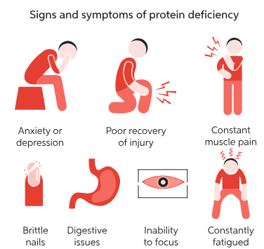
Protein deficiency: Body is missing its building blocks !!!!

Slide 31
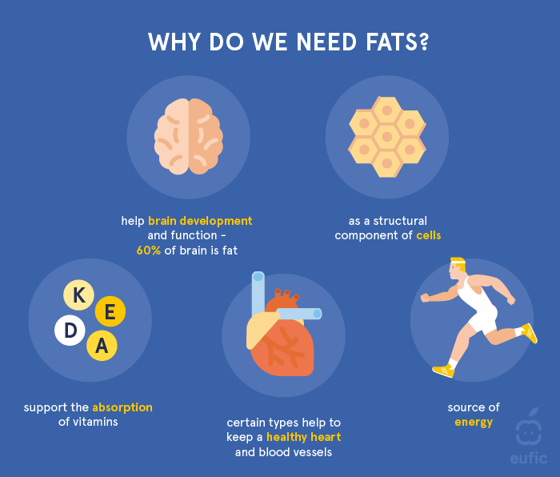
Dietary Lipids
Dietary lipids are primarily oils (liquid) and fats (solid). It is an energy source and when consumed, increases the absorption of fat-soluble vitamins including vitamins A, D, E and K. They are also vital part of cell membrane. 20 to 35 percent of your daily intake should come from fat.

Slide 32
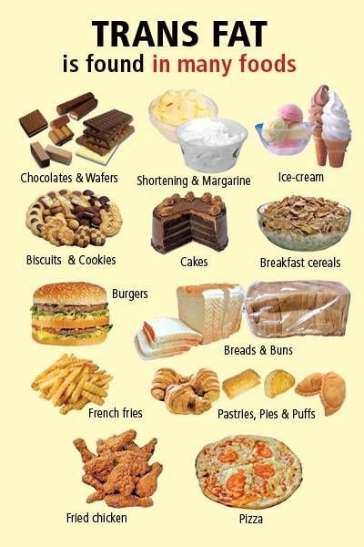
Lipids make up 18-25% of adult body mass, and contain carbon, hydrogen and oxygen
Saturated vs. Unsaturated lipids and Trans Lipids (generally called as trans fat)
The difference between dietary lipids lies in their chemical structure.
In saturated lipid, single covalent bond between carbon and hydrogen. This makes them solid at room temperature. They are found in Red meat, poultry, Whole-milk dairy products like milk, cheese, and ice cream, Butter, Eggs, Palm and coconut oil.
In unsaturated lipid, double bond between carbon and hydrogen. These fats are liquid at room temperature. They come mainly from vegetables, nuts, and fish.
Trans fats are unsaturated fats they are bad for body as they increase low density cholesterol causing damage to arteries.

Slide 33
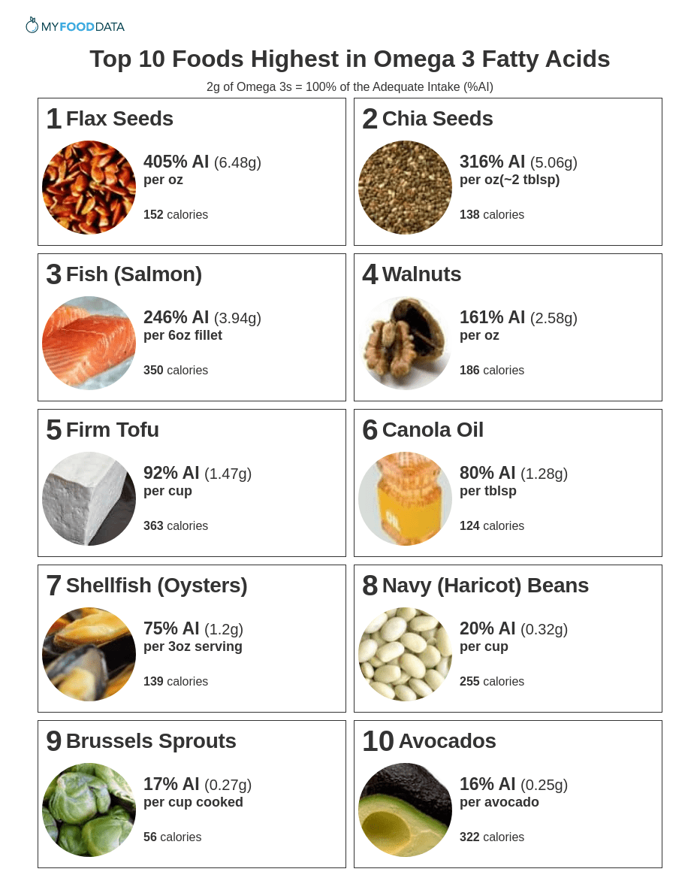
Fatty acids
Fatty acids are the simplest monomer unit (eg. stearic acid, palmitic acid). They can be saturated or unsaturated
Essential and Non-Essential Fatty Acids
A group of fatty acids called the essential fatty acids (EFAs) is important for human health. However, they cannot be synthesized by the human body and must be obtained from foods or supplements.
The more important EFAs are omega-3 fatty acids, omega-6 fatty acids and
cis-fatty acids
Sources of EFA
Types of EFA
Triglyceride (fats and oils)
Phospholipids: It is a major lipid component of cell membranes.
Sphingolipids: Major component of cell membranes
Steroids: These are compounds that have four rings of carbon atoms.
Waxes: They are esters of long-chain fatty acids and long-chain alcohols.

Slide 34
The major functions of fats are:
Energy Storage : Fats primarily function as an energy reserve.
Fats are packed together tightly without water and store far greater amounts of energy in a reduced space.
A gram of fat is densely concentrated with energy—it contains more than double the amount of energy than a gram of carbohydrate.
Regulating and Signalling:
example, adipose tissue secretes the hormone leptin, which regulates appetite
Insulating and Protecting : Lipids help insulate and protect our organs by forming a layer of adipose tissue around them. This layer helps to regulate body temperature and provides cushioning. For example: The layer of fat under the skin helps keep our bodies warm in cold temperatures
Transporting: Fat-soluble nutrients require fat for effective absorption. They are best absorbed when combined
with foods containing fat. Example- eating tomatoes with olive oil or salad dressing will facilitate lycopene absorption.
Commonly consumed oils are canola, corn, olive, peanut, safflower, soy, and sunflower oil. Foods rich in oils include salad dressing, olives, avocados, peanut butter, nuts, seeds, and some fish. Fats are found in animal meat, dairy products, and cocoa butter. Ghee, butter.

Slide 35
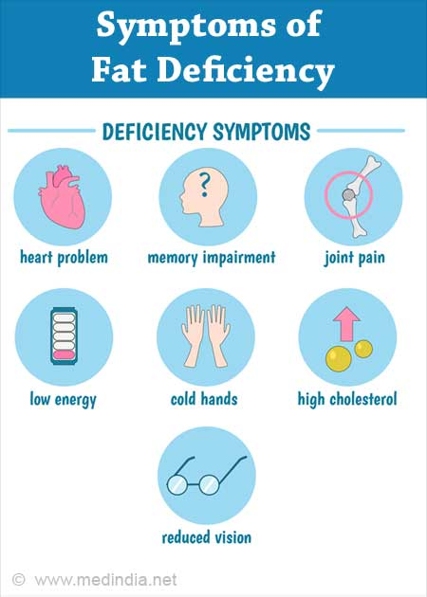

Excessive fat consumption
Bloating or gas
Diarrhoea
Feeling sluggish
Weight gain
Restless sleep

Slide 36
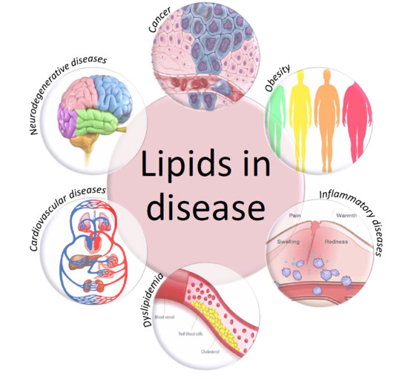

Slide 37
Effects of Excess of fat
Leads to Obesity because more than required calories are consumed. In addition, the excess carbohydrates are also converted to fat for storage in the body resulting in obesity.
Slows down the digestion and absorption of foods.
Interferes with the absorption of calcium by combining with calcium to form an insoluble calcium soap.
Cause ketosis unless adequate carbohydrate is present to complete the oxidation of fat.
Choose healthy options such as omega-3-rich foods like fish, walnuts and vegetable-based oils. Omega-3s help with development and growth.
Limit intake of saturated fats such as high-fat meats and full-fat dairy. Other smart choices include nuts, seeds and avocado.

Slide 38

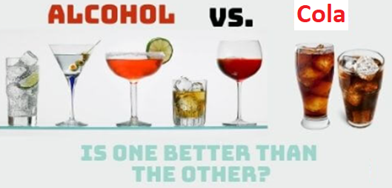

Is any of it is better??
Alcohol Vs colas/fruit juices Vs alcohol with colas/fruit juices
Alcohol in colas/soft drinks
VS
Notes:
Fact: The fatty degeneration of liver cells occurs to a greater degree in NAFLD (Non-alcoholic fatty liver disease) than in ALD (Alcoholic fatty liver disease)

Slide 39
Discussion
1. Which components of food keep on accumulating in our body and contribute to our weight?
2. We are losing weight, what are we actually losing???
3. When losing weight where does the excessive fat goes?????

Slide 40
Vitamins
Vitamins are organic molecules that serve as an essential nutrient for most living organisms for the smooth functioning of their metabolism.
Vitamins are the compounds that people need in less quantities. The body does not produce vitamins on its own. Vitamins are to be obtained from the food we eat.
Vitamins are essential because they prevent various health issues. If the body lacks any vitamin, it may develop a deficiency and a related disease.
Vitamin requirements vary with different organisms. For example, dogs can produce their vitamin C they need, but humans need to acquire that from their diet.

Slide 41
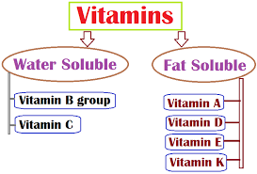
Vitamins
Vitamins A, C, D, E, K and the B (8 variants, hence called B complex) vitamins (Total 13)
Vitamins are groups of related substances present in small amounts in foodstuffs and are necessary for the body to function normally. Vitamins are also called protective foods.
They are grouped together because, as their name implies, they are a vital factor in the diet.
Vitamins are grouped based on their characteristics. They are soluble in fat or water.

Slide 42
The main functions of vitamins are
Help the body maintain good health
Regulating the tissues and help in repairing cells
Fight against ageing
Formation of new cells
Keeping bones, teeth and nails healthy.
Help the muscles and ligaments function smoothly.

Slide 43
Consequences of taking more than required vitamin supplements:
Vitamins are essential for well-being and preventing diseases.
It doesn’t mean that consuming more vitamins would improve health drastically. Consuming too many vitamins may cause an overdose and adversely affect our health.
When vitamins or minerals are consumed in large doses, they can compete with each other to be absorbed. So it is better to restrict consuming calcium, magnesium or zinc supplements. simultaneously.
One should restrict the intake of too many individual vitamins that are fat-soluble, like vitamin A, vitamin D, vitamin E, and vitamin K can cause side effects if it overdoses.
All the vitamins are essential to the body as it plays a vital role in helping the body perform various functions smoothly. But Vitamin D has overall importance and is considered to be the most important vitamin to the body.

Slide 44
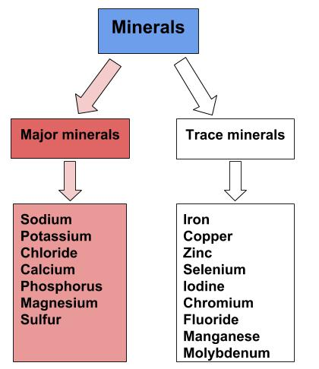
Minerals
Minerals are the substances that people need to ensure the health and correct
working of their soft tissues, fluids and their skeleton. They are important micronutrient
essential for the normal functioning of several bodily
processes.
It has been categorized as major and trace minerals.
There are about 6 major minerals that are present
in the bodies in huge amounts. These minerals are involved
in more than a hundred of vital roles in the body.

Slide 45
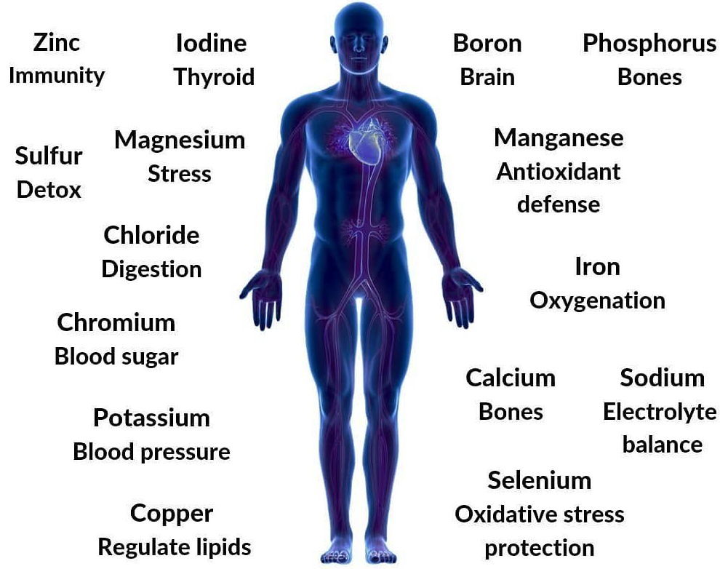
Important Function of each mineral

Slide 46
Calcium is a mineral most often associated with healthy bones and teeth, although it also plays an important role in blood clotting, helping muscles to contract, and regulating normal heart rhythms and nerve functions. About 99% of the body’s calcium is stored in bones, and the remaining 1% is found in blood, muscle, and other tissues.
In order to perform these vital daily functions, the body works to keep a steady amount of calcium in the blood and tissues. If calcium levels drop too low in the blood, parathyroid hormone (PTH) will signal the bones to release calcium into the bloodstream. This hormone may also activate vitamin D to improve the absorption of calcium in the intestines. At the same time, PTH signals the kidneys to release less calcium in the urine. When the body has enough calcium, a different hormone called calcitonin works to do the opposite: it lowers calcium levels in the blood by stopping the release of calcium from bones and signaling the kidneys to rid more of it in the urine.

Slide 47
The body gets the calcium it needs in two ways. One is by eating foods or supplements that contain calcium, and the other is by drawing from calcium in the body. If one does not eat enough calcium-containing foods, the body will remove calcium from bones. Ideally, the calcium that is “borrowed” from the bones will be replaced at a later point. But this doesn’t always happen, and can’t always be accomplished just by eating more calcium.
Calcium is widely available in many foods, not just milk and other dairy foods. Fruits, leafy greens, beans, nuts, and some starchy vegetables are good sources.

Slide 48
Deficiency Symptoms of hypocalcemia/ reduced blood Ca levels:
Muscle cramps or weakness
Numbness or tingling in fingers
Abnormal heart rate
Poor appetite
A gradual, progressive calcium deficiency can occur in people who do not get enough dietary calcium in the long-term or who lose the ability to absorb calcium. The first early stage of bone loss is called osteopenia and, if untreated, osteoporosis follows. Examples of people at risk include:
Postmenopausal women—Menopause lowers the amount of estrogen in the body, a hormone that helps to increase calcium absorption and retain the mineral in bones. Sometimes physicians may prescribe hormone replacement therapy (HRT) with estrogen and progesterone to prevent osteoporosis.
Amenorrhea—A condition where menstrual periods stop early or are disrupted, and is often seen in younger women with anorexia nervosa or athletes who physically train at a very high level.
Milk allergy or lactose intolerance—Occurs when the body cannot digest the sugar in milk, lactose, or the proteins in milk, casein or whey. Lactose intolerance can be genetic or acquired (not consuming lactose in the long-term may decrease the efficiency of lactase enzyme)

Slide 49
Too much calcium in the blood is called hypercalcemia.
can increase risk of some conditions like kidney stones, prostate cancer, and constipation.
Some research has shown that in certain people, calcium can accumulate in blood vessels with long-term high doses and
cause heart problems. Calcium is also a large mineral that can block the absorption of other minerals like iron and zinc.
Symptoms of hypercalcemia:
Weakness, fatigue
Nausea, vomiting
Shortness of breath
Chest pain
Heart palpitations, irregular heart rate

Slide 50
Iodine is an essential trace mineral not made by the body so must be obtained by food or supplements. It is found naturally in some foods and is added to supplements and some salt seasonings. Iodine is needed to make the thyroid hormones thyroxine and triiodothyronine, which assist with the creation of proteins and enzyme activity, as well as regulating normal metabolism. Without enough iodine, these thyroid hormones do not work properly and can lead to an under-active or overactive thyroid gland, causing the medical conditions of hypothyroidism and hyperthyroidism with various negative side effects in the body.
Iodine is found mainly in animal protein foods and sea vegetables, and to a lesser extent in fortified foods like breads, cereals, and milk.
A deficiency of iodine can therefore prevent normal growth and development. This is especially dangerous in pregnant women and infants, in which miscarriage, stillbirth, stunted growth, and cognitive impairments (difficulties with reading, writing, talking, problem solving, social skills) can occur. In adults, an iodine deficiency of less than 10-20 mcg a day can lead to inadequate thyroid hormone production, called hypothyroidism, which disrupts normal metabolic functions like regulating heart rate, body temperature, and body weight. [2] A lump or swelling in the neck, called goiter, often accompanies hypothyroidism.

Slide 51
Iron is an important mineral that helps maintain healthy blood. A lack of iron is called iron-deficiency anemia.
It is the most common nutritional deficiency worldwide, causing extreme fatigue and lightheadedness. It affects all ages, with children, women who are pregnant or menstruating, and people receiving kidney dialysis among those at highest risk for this condition.
Iron is a major component of hemoglobin, a type of protein in red blood cells that carries oxygen from your lungs to all parts of the body. Without enough iron, there aren’t enough red blood cells to transport oxygen, which leads to fatigue. Iron is also part of myoglobin, a protein that carries and stores oxygen specifically in muscle tissues. Iron is important for healthy brain development and growth in children, and for the normal production and function of various cells and hormones.
Iron from food comes in two forms: heme and non-heme. Heme is found only in animal flesh like meat, poultry, and seafood. Non-heme iron is found in plant foods like whole grains, nuts, seeds, legumes, and leafy greens. Non-heme iron is also found in animal flesh (as animals consume plant foods with non-heme iron) and fortified foods.
Heme iron is better absorbed by the body than non-heme iron. Certain factors can improve or inhibit the absorption of non-heme iron. Vitamin C and heme iron taken at the same meal can improve the absorption of non-heme iron.

Slide 52
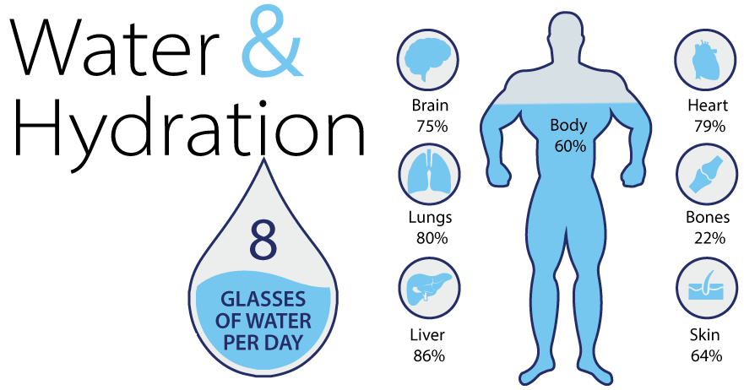
Water
Water helps to maintain homeostasis in the body and transports nutrients to cells. Water also assists in removing waste products from the body.
All beverages and high-moisture foods such as soup and watermelon contain water and count towards your daily water requirement. Adults should consume 25 to 35 millilitres of fluids per kilogram body weight or 2 to 3 liters per day.
Notes:
GCSE Biology - What are Nutrients? Carbohydrates, Lipids, Proteins, Vitamins & Minerals #15 - YouTube

Slide 53
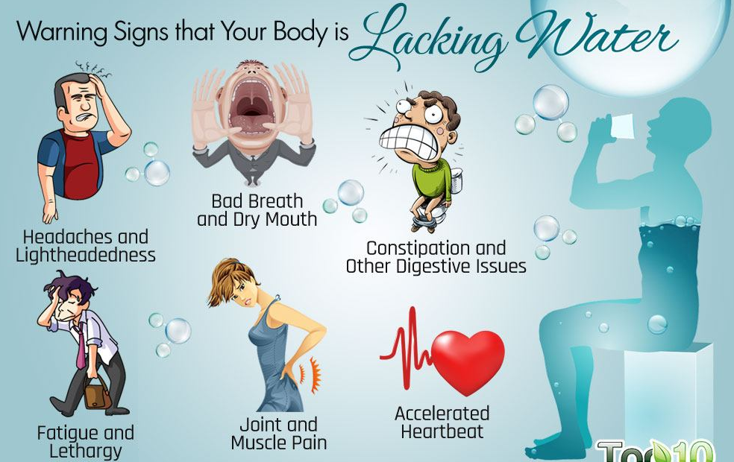

Slide 54
Cooked Food –
The Benefits: There are advantages to cooked food. It does not always lower the nutrient value.
Benefits of cooking food: It destroys bacteria and other harmful organisms that can contaminate food. It breaks down toxins in some foods that may be harmful in the raw food but not when cooked. It removes environmental pollutants. It makes phytochemicals that are unavailable in some raw food more available (e.g. in tomatoes). The food becomes tastier. It makes indigestible vegetables digestible (by breaking them down). It increases the absorption of many nutrients and improves digestion.
How to Preserve the Nutrient Value of Food
It sounds like common sense but preserving nutrient value is often the most overlooked when preparing and cooking foods. Use fresh food – food loses nutrients as it ages.
Cook for the shortest time possible – food also loses nutrients during long cooking.
Scrub and wash vegetables thoroughly and don’t peel them. Always try to use the outer leaves of leafy vegetables if they are in good condition.
Use vegetable cooking water for stock or sauces (but avoid boiling if possible and steam, grill, roast or microwave instead). Store food in airtight containers and keep it in the refrigerator; store vegetables in the fridge crisper.

Slide 55
THE EFFECT OF COOKING AND PROCESSING METHODS ON NUTRIENTS
The method of processing often affects vitamin content and availability. Water soluble vitamins can be affected by heat, acid, and other cooking methods, regardless of the type of the dish. Water soluble vitamins can leach into cooking water. This means some vitamin content is often lost through evaporation.
Degradation will depend on the amount of heat applied. Cooking can also make these vitamins more bioavailable. Conversely, it can also degrade these vitamins, ultimately reducing the overall content. It is difficult to consume too much of a water-soluble vitamin, because excess is excreted. This group includes the B vitamins and vitamin C.
Fat soluble vitamins are also affected by cooking. They will not leach into cooking water, but can leach into fats such as olive oil or butter. These vitamins can degrade with cooking, but not as easily as water soluble vitamins do. When consumed in excess, fat soluble vitamins can be stored in the body's fat deposits. Over time, this accumulation can be dangerous. This groups includes vitamins A, D, E, and K.
Vitamins that are the most unstable when cooked/processed and stored: Ascorbic Acid (vitamin C) Folic Acid (vitamin B9) Thiamine (vitamin B1) Vitamins that are more stable when cooked, processed or stored: Niacin (vitamin B3) Pantothenic acid (vitamin B5) Biotin (vitamin B7) Vitamin D Vitamin K

Slide 56
It is important that food is cooked right so that its nutrients are not lost. Vegetables and fruits must be washed before cutting them which will prevent the loss of nutrients. ... Many nutrients and minerals are lost when excess water used for cooking is thrown away. Overcooking of food must also be avoided.
Keep skins on when possible.
Long exposure to heat and Avoid continuous reheating of food.
Use a minimal amount of cooking liquid.
Most vitamins are sensitive to the heat hence cook the food the required time only.
Choose steaming over boiling.
When you do boil, retain the cooking liquid for a future use (like soups and stocks)
do not store the food. Freshly prepared food is the best way to receive all the nutrients.

Slide 57
Extra Reading……Vitamins

Slide 58
Vitamins
can be classified based on their solubility. Most vitamins are water-soluble, In contrast, fat-soluble vitamins are similar to oil and do not dissolve in water.
Fat-soluble vitamins are most abundant in high fat foods and are much better absorbed into your bloodstream when you eat them with fat.
There are four fat-soluble vitamins in the human diet:
vitamin A
vitamin D
vitamin E
vitamin K
Vitamin C is necessary for the synthesis of collagen, which provides structure to blood vessels, bone and ligaments. Folate, found in foods, helps to prevent birth defects.
Vitamin D helps to maintain calcium homeostasis. It can be found in food sources or synthesized by the sun.

Slide 59
They are essential for health and play many important roles in the body.
With the exception of vitamin D, most of them are easy to get from a diet that includes a variety of foods, especially if you eat plenty of nuts, seeds, vegetables, fish, and eggs.
These vitamins tend to be abundant in fatty foods, and you can enhance their absorption by adding fat or oil to an otherwise low fat meal.
Few foods are naturally rich in vitamin D. It’s abundant in fatty fish and fish oil but also formed by your skin when you’re exposed to sunlight. For this reason, vitamin D deficiency can occur in people who do not eat a diet filled with a variety of nutrient-rich foods and regularly spend time indoors, which may be due to a variety of factors, including medical reasons or personal choice.
While you generally do not need to supplement with vitamin A, E, and K, taking vitamin D supplements is widely recommended.
For optimal health, make sure you get all the fat-soluble vitamins in adequate amounts.

Slide 60
Vitamin A
Vitamin A plays a key role in maintaining your vision. Without it, you would go blind.
Vitamin A is not a single compound. Rather, it is a group of fat-soluble compounds collectively known as retinoids.
Vitamin A is only found in animal-sourced foods. The main natural food sources are:
Liver, fish liver oil, butter. It is abundant in many vegetables, such as carrots, kale, and spinach
Vitamin A supports many critical aspects of your body function, including:
Vision maintenance. Vitamin A is essential for maintaining the light-sensing cells in your eyes and for the formation of tear fluid
Immune function. Vitamin A deficiency impairs your immune function, increasing susceptibility to infections
Body growth. Vitamin A is necessary for cell growth in your body. Deficiency may slow or prevent growth in children
Hair growth. It is also vital for hair growth. Deficiency leads to alopecia, or hair loss
Reproductive function. Vitamin A maintains fertility and is vital for fetal development

Slide 61
Deficiency is also widespread in some developing countries where food variety is limited. It is common in populations whose diet is dominated by refined rice, white potatoes, and lacking in meat, fat, and vegetables.
A common symptom of early deficiency includes night blindness. As it progresses, it may lead to more serious conditions, such as:
Dry eyes. Severe deficiency may cause xerophthalmia, a condition characterized by dry eyes caused by reduced tear fluid formation
Blindness. Serious vitamin A deficiency may lead to total blindness. In fact, it is among the most common preventable causes of blindness in the world
Hair loss. If you are vitamin A deficient, you may start to lose your hair
Skin problems. Deficiency leads to a skin condition known as hyperkeratosis, or goose flesh
Poor immune function. Poor vitamin A status or deficiency makes you prone to infections
Overdosing on vitamin A leads to an adverse condition known as hypervitaminosis A. It’s rare but may have serious health effects.
Its main causes are excessive doses of vitamin A from supplements.
While supplements are beneficial for those who have a deficiency, most people get enough vitamin A from their diet and do not need to take supplements.

Slide 62
Vitamin D
Nicknamed the sunshine vitamin, vitamin D is produced when your skin when is exposed to sunlight.
It is best known for its beneficial effects on bone health. Deficiency makes you highly susceptible to bone fractures.
It is known as calciferol, and comes in two main dietary forms:
Vitamin D2 (ergocalciferol). This form is found in mushrooms and some plants.
Vitamin D3 (cholecalciferol). This form is found in animal-sourced foods, such as eggs and fish oil, and produced when your skin is exposed to sunlight.

Slide 63
Vitamin D has numerous roles and functions, These include the following:
Bone maintenance. Vitamin D regulates the circulating levels of calcium and phosphorus, which are the most important minerals for bone growth and maintenance. It promotes the absorption of these minerals from your diet.
Immune system regulation. It also regulates and strengthens your immune system function
Once absorbed into the bloodstream, your liver and kidneys change calciferol into calcitriol, which is the biologically active form of vitamin D. It can also be stored for later use.
Vitamin D3 is more efficiently converted into calcitriol than vitamin D2
Your body can produce all the vitamin D it needs as long as you regularly expose large parts of your skin to sunlight. However, many people spend little time in the sun or do so fully clothed. Justifiably, others cover their skin with sunscreen to prevent sunburns. While sunscreen use is highly recommended, it reduces the amount of vitamin D your skin produces.
As a result, people generally need to rely on their diets to get enough vitamin D.
Few foods naturally contain vitamin D. The best dietary sources are fatty fish and fish oil, but mushrooms that have been exposed to ultraviolet light may also contain significant amounts.
In addition, dairy products and margarine often come with added vitamin D.

Slide 64
The most well-known consequences of vitamin D deficiency include soft bones, weak muscles, and an increased risk of bone fractures. This condition is called osteomalacia in adults and rickets in children
is also associated with poor immune function, increased susceptibility to infections, and autoimmune diseases.
Severe vitamin D deficiency is rare, but mild forms of deficiency or insufficiency are common among people who are hospitalized as well as older adults.
Vitamin D toxicity is very rare.
While spending a lot of time in the sun does not cause vitamin D toxicity, taking high amounts of supplements may harm you.
The main consequence of toxicity is hypercalcemia, a condition characterized by excessive amounts of calcium in the blood.
People are generally advised to avoid exceeding the upper limit of vitamin D intake, which is 4,000 IU per day for adults.

Slide 65
Vitamin E
As a powerful antioxidant, vitamin E protects your cells against premature aging and damage
It is a family of eight structurally similar antioxidants that are divided into two groups:
Tocopherols and Tocotrienols
The antioxidant properties are enhanced by other nutrients, such as vitamin C, vitamin B3, and selenium.
The richest dietary sources of vitamin E include certain vegetable oils, seeds, and nuts. Other rich sources include avocados, peanut butter, margarine, fatty fish, and fish liver oil.
Vitamin E deficiency is uncommon and is never detected in people who are otherwise healthy.
It happens most often when diseases that impair the absorption of fat or vitamin E from food, such as cystic fibrosis and liver disease, are present.
Severe, long-term deficiency may lead to anemia, heart disease, serious neurological problems, blindness, dementia, poor reflexes, and the inability to fully control body movements
Overdosing on vitamin E is difficult when it is obtained from natural dietary sources. Cases of toxicity have only been reported after people have taken very high doses of supplements.
It may have blood-thinning effects, counteracting the effects of vitamin K and causing excessive bleeding. Thus, people who take blood-thinning medications should avoid taking large doses of vitamin E

Slide 66
Vitamin K
Vitamin K plays a key role in blood clotting. Without this essential vitamin, there’s a higher risk of excessive bleeding, which could lead to death.
Vitamin K is actually a group of fat-soluble compounds divided into two main groups:
Vitamin K1 Found in plant-sourced foods, mainly leafy vegetables
Vitamin K2 This variety of vitamin K is found in animal-sourced foods like egg yolks, butter, and liver and fermented soy products, like natto. Vitamin K2 is also produced by gut bacteria in the colon
Vitamin K plays an essential role in blood clotting. In fact, the “K” stands for “koagulation,” the Danish word for coagulation, which means clotting.
But vitamin K has other functions as well, including supporting bone health and helping prevent the calcification of blood vessels, potentially reducing the risk of heart disease

Slide 67
vitamin K is not stored in the body in significant amounts. For this reason, consuming a diet lacking in vitamin K may lead you to become deficient in as little as a week. People who do not efficiently digest and absorb fat are at the greatest risk of developing vitamin K deficiency.
Use of broad-spectrum antibiotics may also raise the risk of deficiency, as well as very high doses of vitamin A, which seem to reduce vitamin K absorption.
Low levels of vitamin K have also been linked with reduced bone density and increased risk of fractures in women
Unlike the other fat-soluble vitamins, natural forms of vitamin K have no known symptoms of toxicity.

Slide 68
Water soluble vitamins- C & B complex
There are nine water-soluble vitamins: the B vitamins --, B1-thiamine, B2-riboflavin, B3-niacin, B5-pantothenic acid, B7-biotin, vitamin B6, vitamin B9- folate and vitamin B12- cobalamin and vitamin C.
Although the vitamins included in this classification are all water-soluble, the degree to which they dissolve in water is variable. This property influences the route of absorption, their excretion, and their degree of tissue storage
Water-soluble vitamins usually are excreted in the urine of humans. Thiamin, riboflavin, vitamin B₆, vitamin C, B5, B7 appear in urine as free vitamins; however, little free niacin is excreted in the urine. Products (also called metabolites) that are formed during the metabolism of thiamin, niacin, and vitamin B₆ also appear in the urine. Urinary metabolites of biotin, riboflavin, and pantothenic acid also are formed.
Excretion of these vitamins (or their metabolites) is low when intake is sufficient for proper body function. If intake begins to exceed minimal requirements, excess vitamins are stored in the tissues. Tissue storage capacity is limited, however, and, as the tissues become saturated, the rate of excretion increases sharply. vitamin B₁₂ is excreted solely in the feces

Slide 69
The water-soluble vitamins generally are not considered toxic if taken in excessive amounts.
There is, however, one exception in humans: large amounts (50–100 mg; 1 mg = 0.001 gram) of niacin produce dilation of blood vessels; in larger amounts, the effects are more serious and may result in impaired liver function.
Thiamin given to animals in amounts 100 times the requirement (i.e., about 100 mg) can cause death from respiratory failure. Therapeutic doses (100–500 mg) of thiamin have no known toxic effects in humans (except rare instances of anaphylactic shock in sensitive individuals). There is no known toxicity for any other B vitamins.

Slide 70
B1 Thiamine-The richest dietary sources of thiamine include nuts, seeds, whole grains, liver and pork.
Deficiency is uncommon, but high blood sugar levels may increase thiamine elimination via urine, raising its requirements and the risk of deficiency.
B2 Riboflavin is the only water-soluble vitamin used as a food coloring. Riboflavin functions as a coenzyme in various chemical reactions. good sources of riboflavin include eggs, leafy vegetables, broccoli, milk, legumes, mushrooms and meat. Riboflavin deficiency is very rare in developed countries. However, a poor diet, old age, lung diseases and alcoholism may increase the risk.
B3 Niacin, also known as vitamin B3, is the only B vitamin your body can produce from another nutrient — the amino acid tryptophan. Like the other B vitamins, it functions as a coenzyme in the body, playing an essential role in cellular function and acting as an antioxidant. metabolic process known as glycolysis, the extraction of energy from glucose (sugar).
Folate (B9) is converted to tetrahydrofolate and is vital for DNA and RNA synthesis. Deficiency can result in neural tube defects, prompting folate supplementation during pregnancy, and anemia. Folate deficiency may also be a feature of alcohol use disorder

Slide 71
Vit B-5 It is used to make coenzyme A (CoA), a chemical compound that helps enzymes to build and break down fatty acids as well as perform other metabolic functions.
Because pantothenic acid helps to break down fats, it has been studied for a potential role in reducing cholesterol levels in people who have dyslipidemia. This is a condition in which there is an abnormally high concentration of fat or lipids in the blood (e.g., LDL “bad” cholesterol, triglycerides), and low levels of HDL “good” cholesterol. Low levels of CoA may prevent the breakdown and clearance of fats in the blood. [3] It has also been proposed that pantothenic acid may have an antioxidant effect that reduces low-grade inflammation, which is present in the early stages of heart disease. The best sources are beef, chicken, organ meats, fortified cereals, and some vegetables.
Vitamin B6 has been widely studied for its role in disease prevention. The vitamin in supplement form shows the most promise for the treatment of pregnancy-induced nausea, but such use should only occur under the supervision of a physician. Adequate blood levels of B6 may be associated with lower risk of cancers, compared to low blood levels. Vitamin B6 is found in a variety of animal and plant foods.
Biotin supplements are often glamorized as a treatment for hair loss and to promote healthy hair, skin, and nails. Although a deficiency of biotin can certainly lead to hair loss and skin or nail problems, evidence showing a benefit of supplementation is inconclusive. Beef liver, Eggs (cooked),Salmon,Avocados,Pork, Sweet potato, Nuts, seeds

Slide 72
Vitamin B12 is needed to form red blood cells and DNA. It is also a key player in the function and development of brain and nerve cells. B12 deficiency will present with neurologic symptoms. Fish, shellfish,Liver,Red meat,Eggs, Poultry
Dairy products such as milk, cheese, and yogurt. It is estimated that up to 15% of the general population has a vitamin B12 deficiency.
People who do not eat meat, fish, poultry, or dairy are at risk of becoming deficient in vitamin B12, since it is only found naturally in animal products. Studies have shown that vegetarians have low vitamin B blood levels. For this reason, those who follow a vegetarian or vegan diet should include B12-fortified foods or a B12 supplement in their diets. This is particularly important for pregnant women, as the fetus requires adequate vitamin B12 for neurologic development and deficiency can lead to permanent neurological damage.
Signs of deficiency: Fatigue, weakness, Nerve damage with numbness, tingling in the hands and legs, Memory loss, confusion,Dementia,Depression,Seizures

Slide 73
Vit.C is not well stored in body, so it must be taken daily through food or supplements. Vitamin C (ascorbic acid, ascorbate) is needed for collagen growth, wound healing, bone formation, enhancing the immune system by stimulating the activity of white blood cells, absorption of iron, strengthening blood vessels, and acting as an antioxidant. The vitamin helps make several hormones and chemical messengers used in the brain and nerves. When deficiency occurs, it can result in scurvy which can present with swollen and bleeding gums, loss of teeth, poor wound healing, and poor tissue growth.
Citrus (oranges, kiwi, lemon, grapefruit),Bell peppers,Strawberries,Tomatoes,Cruciferous vegetables (broccoli, , cabbage, cauliflower),White potatoes

